Slide 1
Communication Skills
Your key to personal and professional success

Slide 2
How important is communication in your everyday life?
Oh, I’m not a politician or a lawyer so I won’t have to make speeches or fight a case .
I took a communication class once in college.

Slide 3
Explaining the importance of communication is like explaining the importance of breathing!

Slide 4
Why do we communicate?
Expressing our thoughts, our ideas, our feelings, our views
Sharing information
Giving advice
Teaching
Consulting
Learning
Writing rules and laws
For expressing our creativity
For expressing our life philosophy
Sharing the findings of our research work
Selling goods and services
Publicity and advertising
Networking with people with common interests

Slide 5
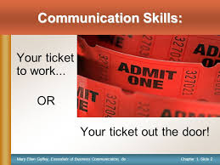

Slide 6
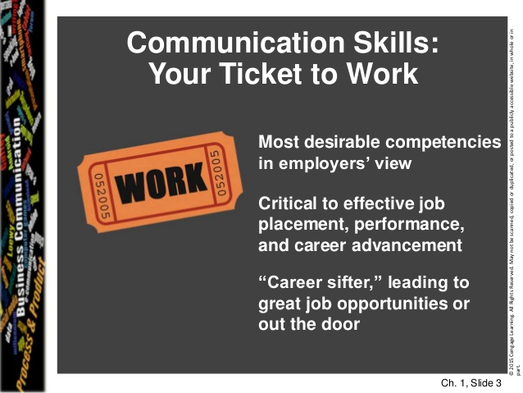

Slide 7
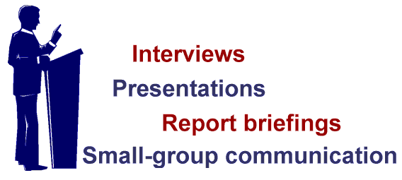
Importance of Communication at Workplace
Employers hire effective communicators
Survey: 500 executives link communication skills to professional success

Slide 8
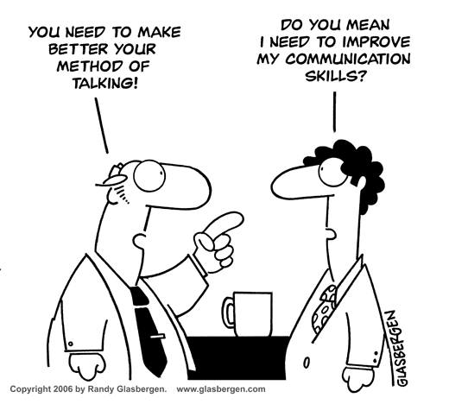

Slide 9
Myths about Writing at Workplace Will I really have to write?
Secretaries will do all my writing.
I’ll use form letters and templates when I need to write.
I’m being hired as a physicist/economist, not a writer.
I’ll just pick up the phone.

Slide 10
Facing Today’s Communication Challenges
“If I went back to college again, I’d concentrate on two areas: learning to write and to speak before an audience. Nothing is more important than the ability to communicate effectively.”
Gerald R. Ford, 38th President of the United States

Slide 11
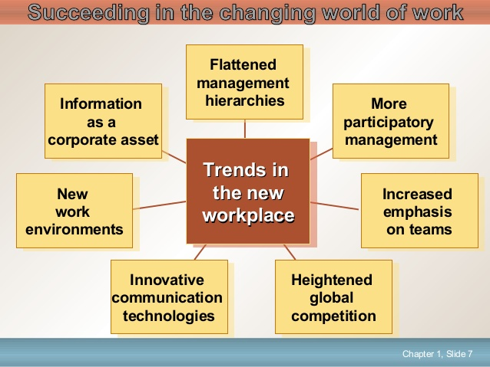

Slide 12
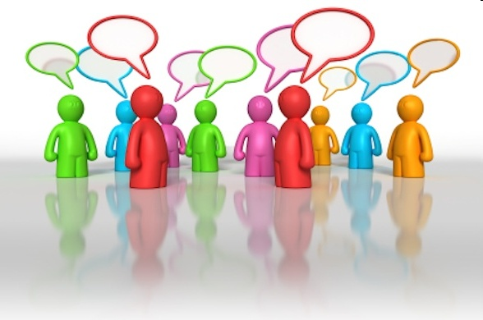
Process of Communication

Slide 13
Communication is the transmission of information and meaning from one individual or group to another.
Communication ---------dynamic interactive process

Slide 14
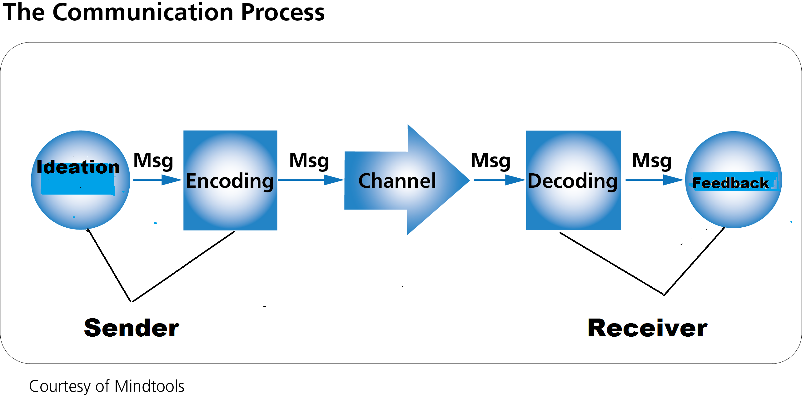

Slide 15
Ideation
Formation of idea or selection of a message to be communicated.
Consists of “What” of communication------content of the specific message.
Scope of ideation------determined by the sender’s knowledge, experiences and abilities as well as the purpose of communication and the context.

Slide 16
Types of Messages
Logical -----Factual information
Emotional------Feelings and emotions

Slide 17
Ideation in a Formal Communicative Situation
Finding and selecting a subject or general topic
Looking for ideas and thoughts
Deciding the type and sources of information.

Slide 18
Encoding
The process of changing the information into some form of logical and the coded message.
In a formal situation, encoding involves:
Selecting a language
Selecting a medium of communication
Selecting an appropriate communication form

Slide 19
Communication Forms
Form | Examples
Interpersonal face to face communication Group Communication Speaker-audience Communication Telephonic Communication Written Communication | Casual conversations, formal interaction, interviews Meetings, conferences Speeches, seminars Personal interactions, business deals Reports, memos, proposals, letters, emails

Slide 20
Transmission
Flow of message over the chosen channel
One of the most basic aspects of communication-----involves choosing the proper time (When), proper place (Where) and a proper way (how).

Slide 21
Decoding
The process of converting a message into thoughts by translating the received message into an interpreted meaning in order to understand the message communicated.
Interpretation of the message.
Oral communication----listening and understanding
Written communication------ reading and understanding

Slide 22
Response
The action or reaction of the receiver to the message.
Feedback ------ acceptance or rejection
Key to communication

Slide 23
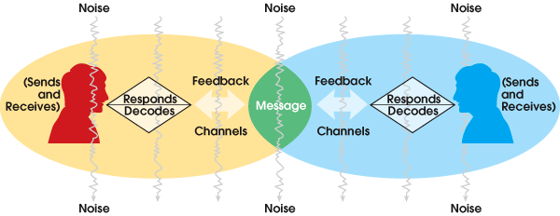
……. Continued

Slide 24
Some Basic Truths about Communication
Meanings sent are not always received
No two minds have identical filters, storehouses of words, gestures, facial expressions
They might not attach same meanings to all symbols

Slide 25
………………….Continued
The symbols of communication are imperfect
Words are crude substitutes for the real thing
Man, dog, house and run etc.
Communicators vary in their ability to communicate thoughts
Lack of equivalent words in various cultures

Slide 26
Resulting stress on adaptation
Adaptation of messages to the minds of receivers
Adaptation ---- fitting the message to the recipients

Slide 27

Thank You

